Slide 1

FPT ACADEMY INTERNATIONAL FPT-APTECH COMPUTER EDUCATION
eProject group 04
WEBSITE
FSM - Prominent
Class T1.2011.M0 – Mr. Le Thanh Nhan
SeriNo
Name
Roll No.
1
PHAM THIEN LONG
Student1285597
2
BUI DANG THANG
Student1281546
3
NGUYEN THI ANH THU
Student1286315
4
TRAN TRUNG NGHIA
Student1286083

Slide 2
Introduce
FSM - Prominent is a fashion store established during the "war" period against the covid-19 epidemic in 2021 and is one of the most trusted and supported stores in Vietnam.
The epidemic situation is still dangerous, sitting at home and with just a few clicks you can shop very easily when using the FSM - Prominent website. Product quality is always in the top of fashion websites on the market today, with extremely affordable prices - free shipping in a fast time. One of the things that make up our brand.
Beside that , we are also very interested in the feeling of using the website from the same basic functions to the most complex functions, we still try to give users a comfortable and comfortable feeling. incredibly easy. Do not hesitate to stop by FSM - Prominent shop to shop for yourself the most beautiful - trendy outfits that are extremely affordable for us?

Slide 3

Customers are more and more inclined to look for what they need online, where everything is much cheaper due to low maintenance (unlike in a physical store where business owners have to worry about maintenance costs and money to rent).
Realizing that traditional marketing platforms would not support sales, FSM - Prominent decided to adopt an Internet approach as E-Commerce has become the fastest growing platform for businesses.
Purpose
Whether the business of a business of a store goes up or not depends largely on the level of customer satisfaction and trust. Through the website, customers can have positive or negative feedback from which businesses can draw out shortcomings and adjust to match customer requirements and at the same time allow them to access and expand. their customer base.
Compared to the cost of building and operating a traditional store. Building an "online store" is considered more economical. Moreover, in the context of social distancing due to the Covid-19 pandemic, when businesses are struggling with store closures, the price of premises. Online sales websites are still operating effectively, bringing in revenue for businesses.

Slide 4
Customers' convenience and benefits
The website must allow customers visiting the website to browse and search for products by using search terms or filtering the categories and attributes of the products. They can compare products.
A customer can leave a review or inquiry about the product and review the product.
The site must allow administrators (store owners and others appointed to the job) to view, update (when required) existing products, categories, product attributes, orders, and more. order has been placed, customer feedback on the product....
The website must allow customers visiting the website to browse and search for products by using search terms or filtering the categories and attributes of the products. They can compare products.

Slide 5
Active Method
Admin
User
Admin can manage ( view , edit , delete ) products , Product-type , category , account , etc.
Order processing ( view , accept or deliver , delete )
Manage email from user ( view , reply)
View product / order / change information
use wishlist , comepare page , …

Slide 6
Advantages
Customers can view detailed or overview information and order pants, shirts, shoes, etc. available on the website.
Customers can leave feedback for the store
Customers can also see the store's street address to visit or shop directly through the Contact section
It is possible to search specifically for the name of the fruit that the customer needs.

Slide 7
Specific Job Details Of Each Member

Slide 8
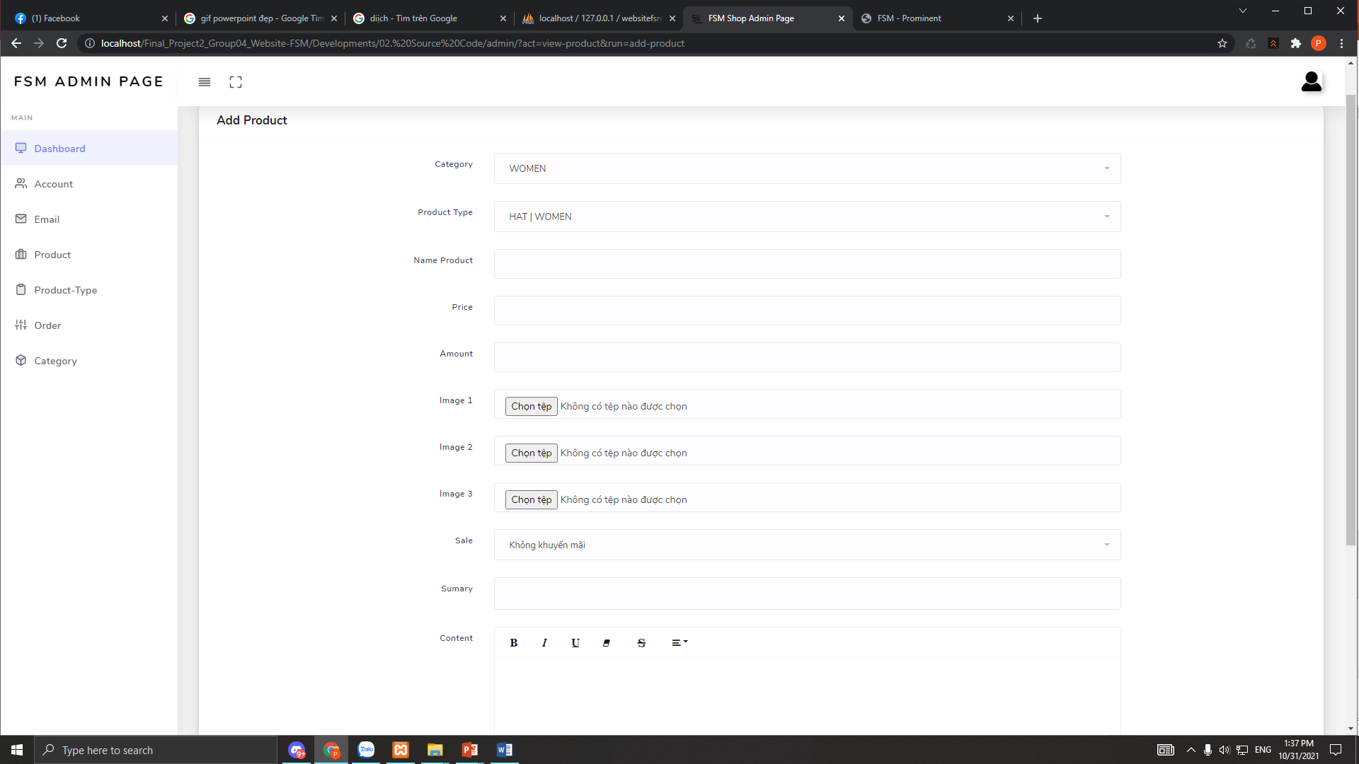
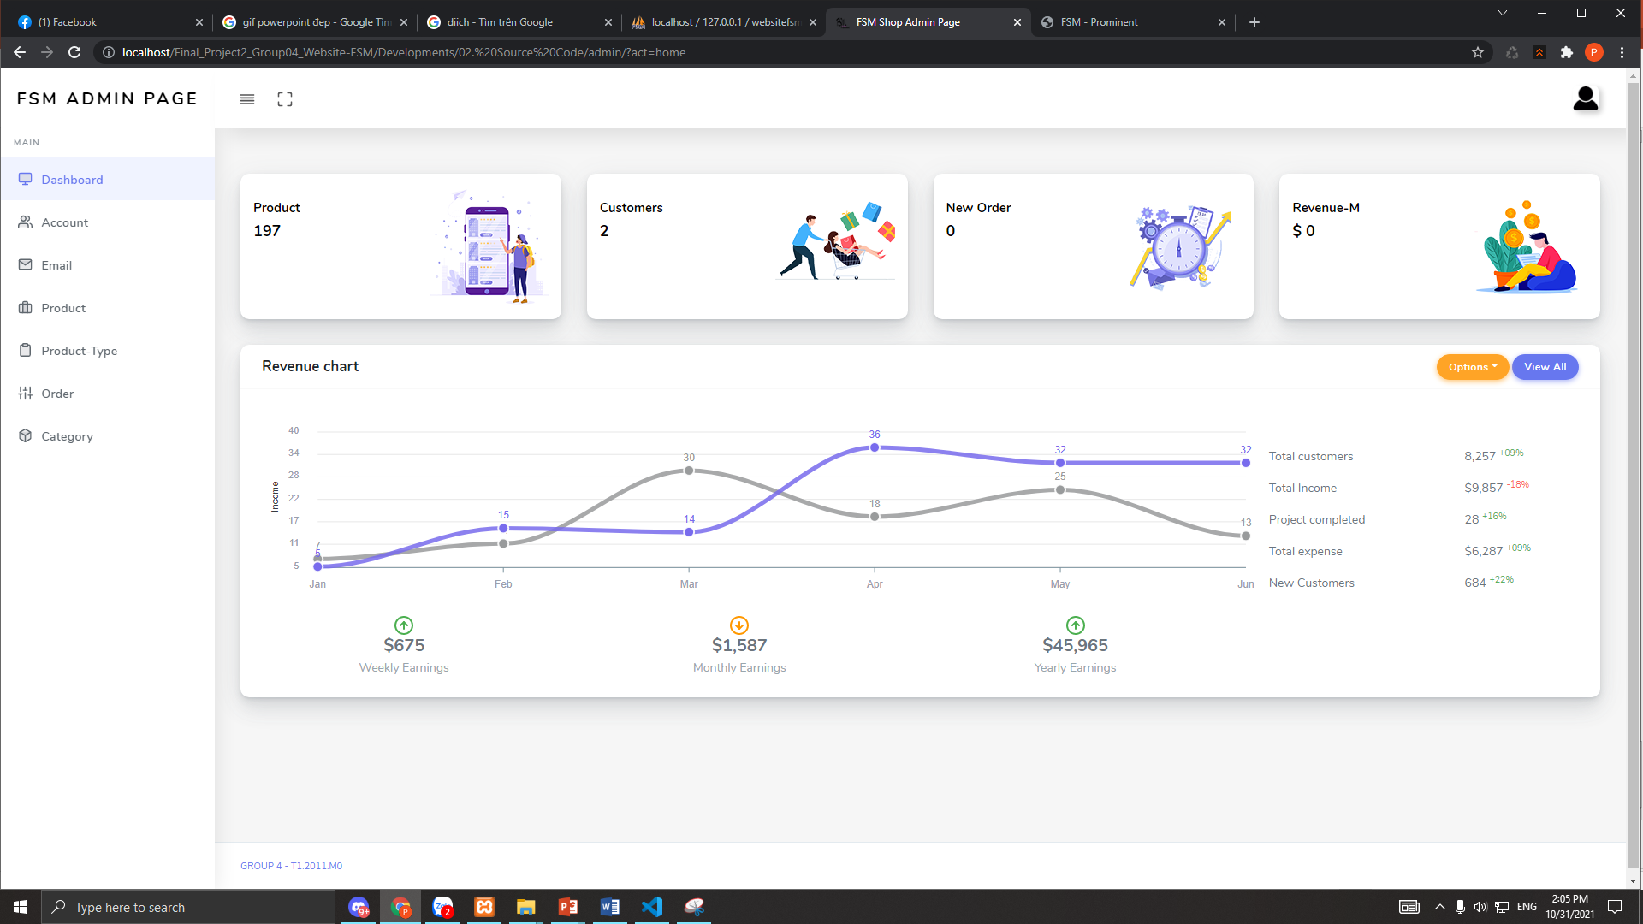
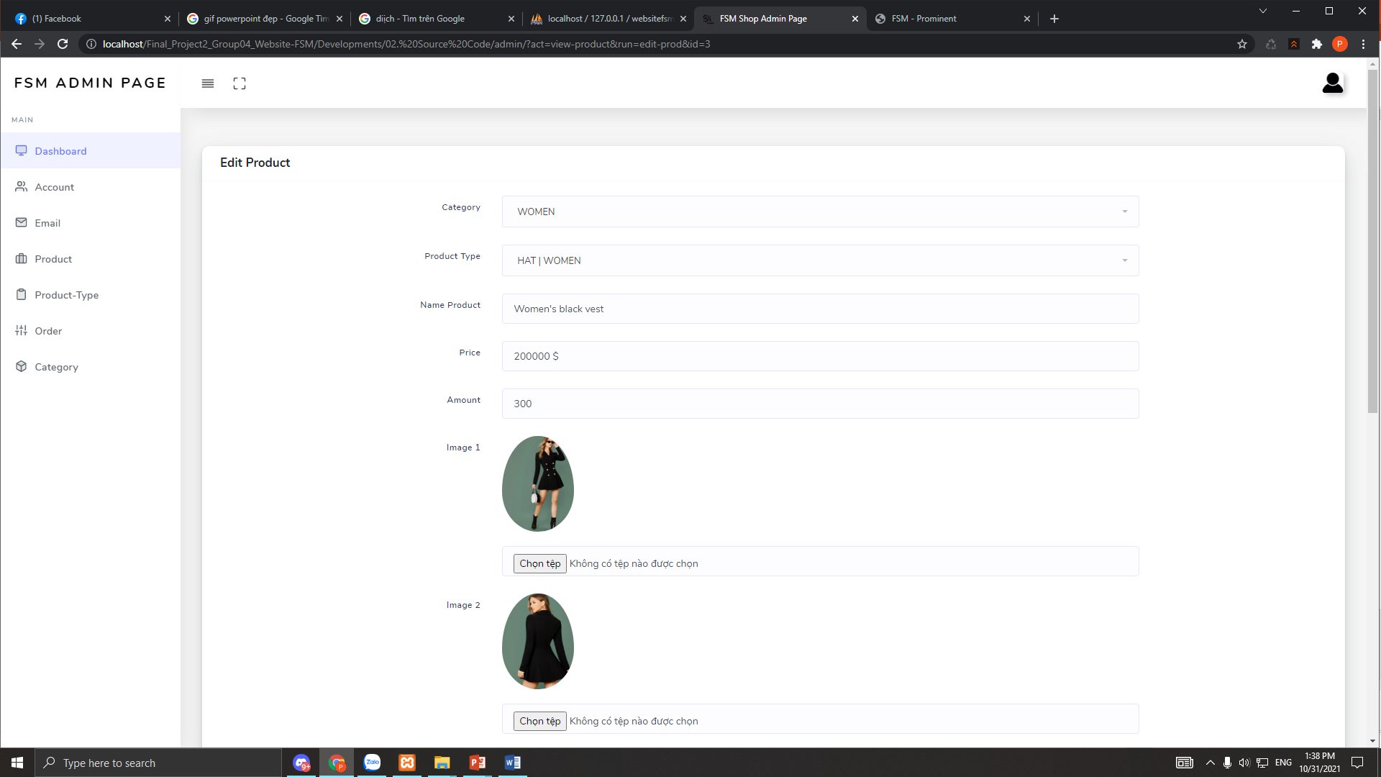
Add product page
PhAM THIEN LONG
Admin page
Edit product page

Slide 9
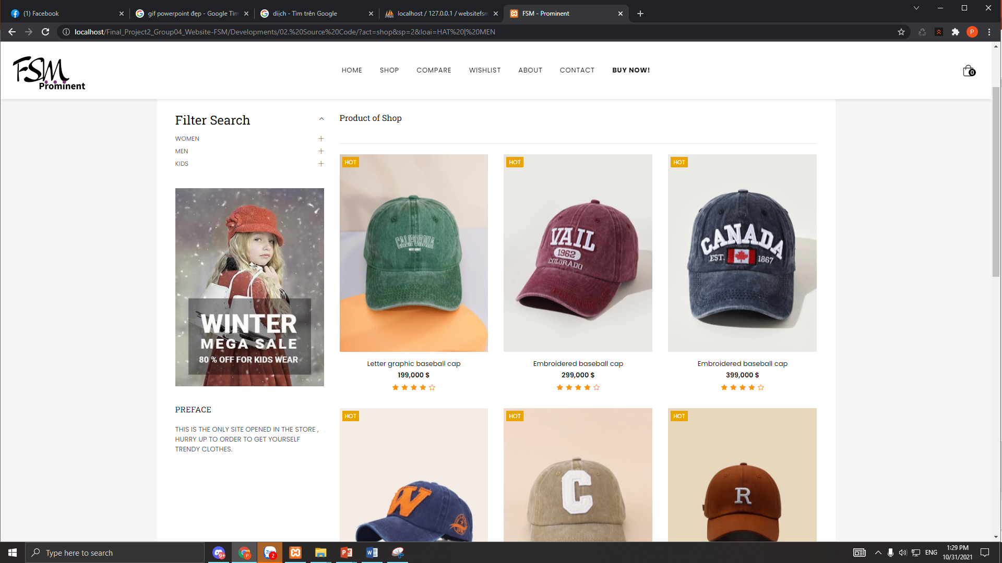
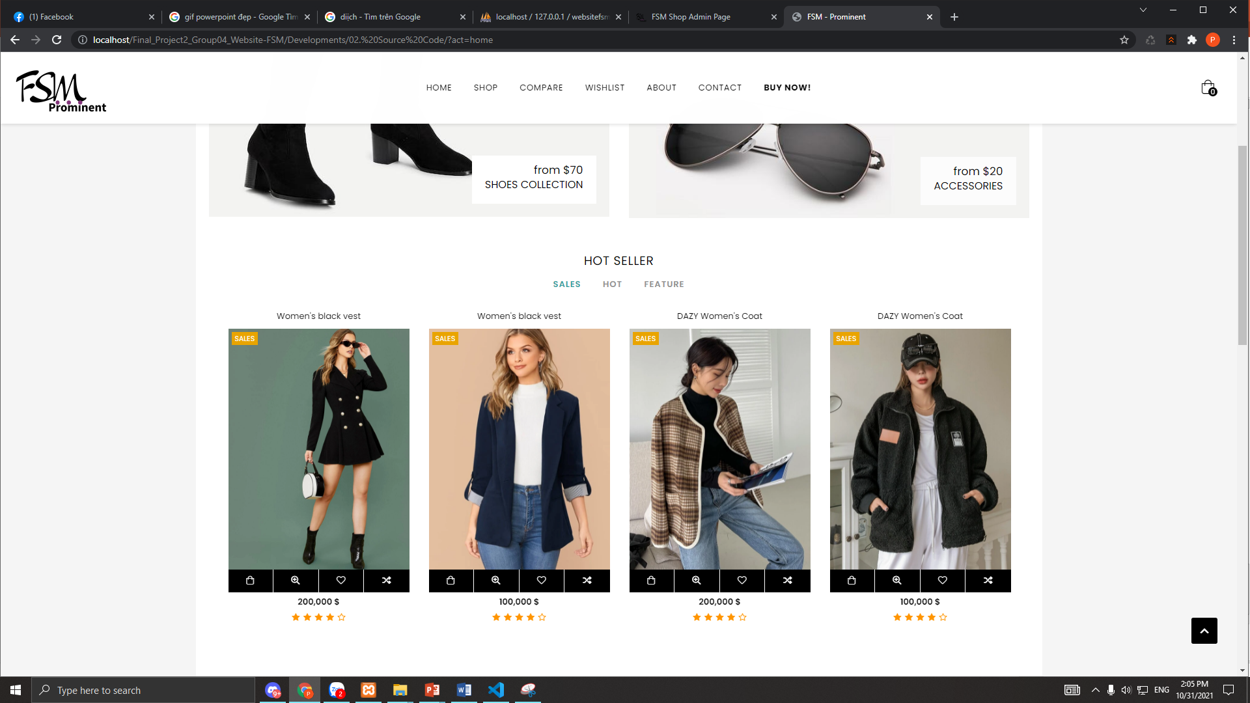
Shop page
PhAM THIEN LONG
Home page

Slide 10
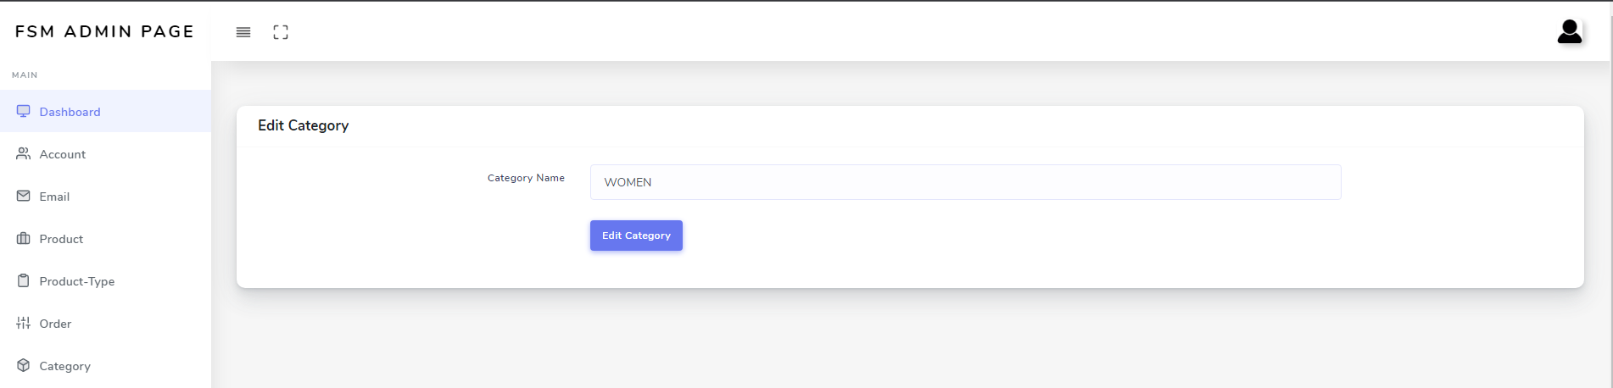
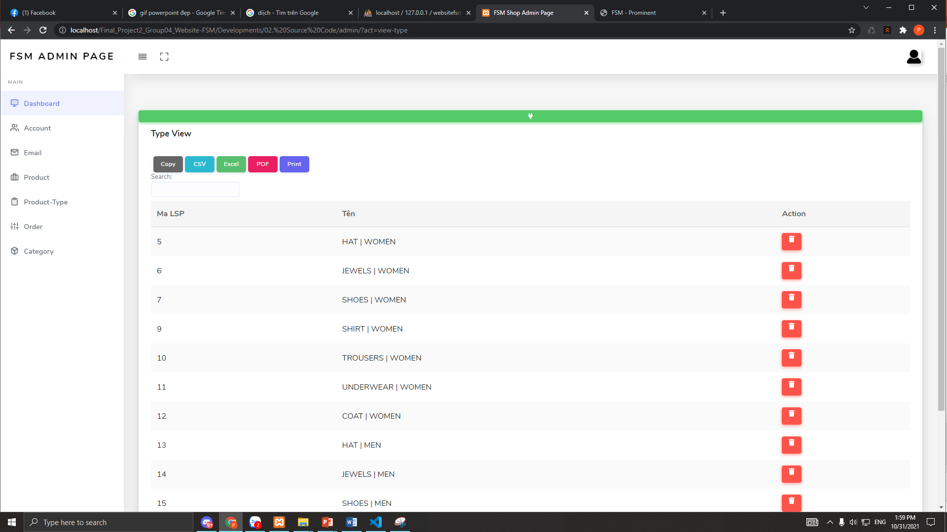
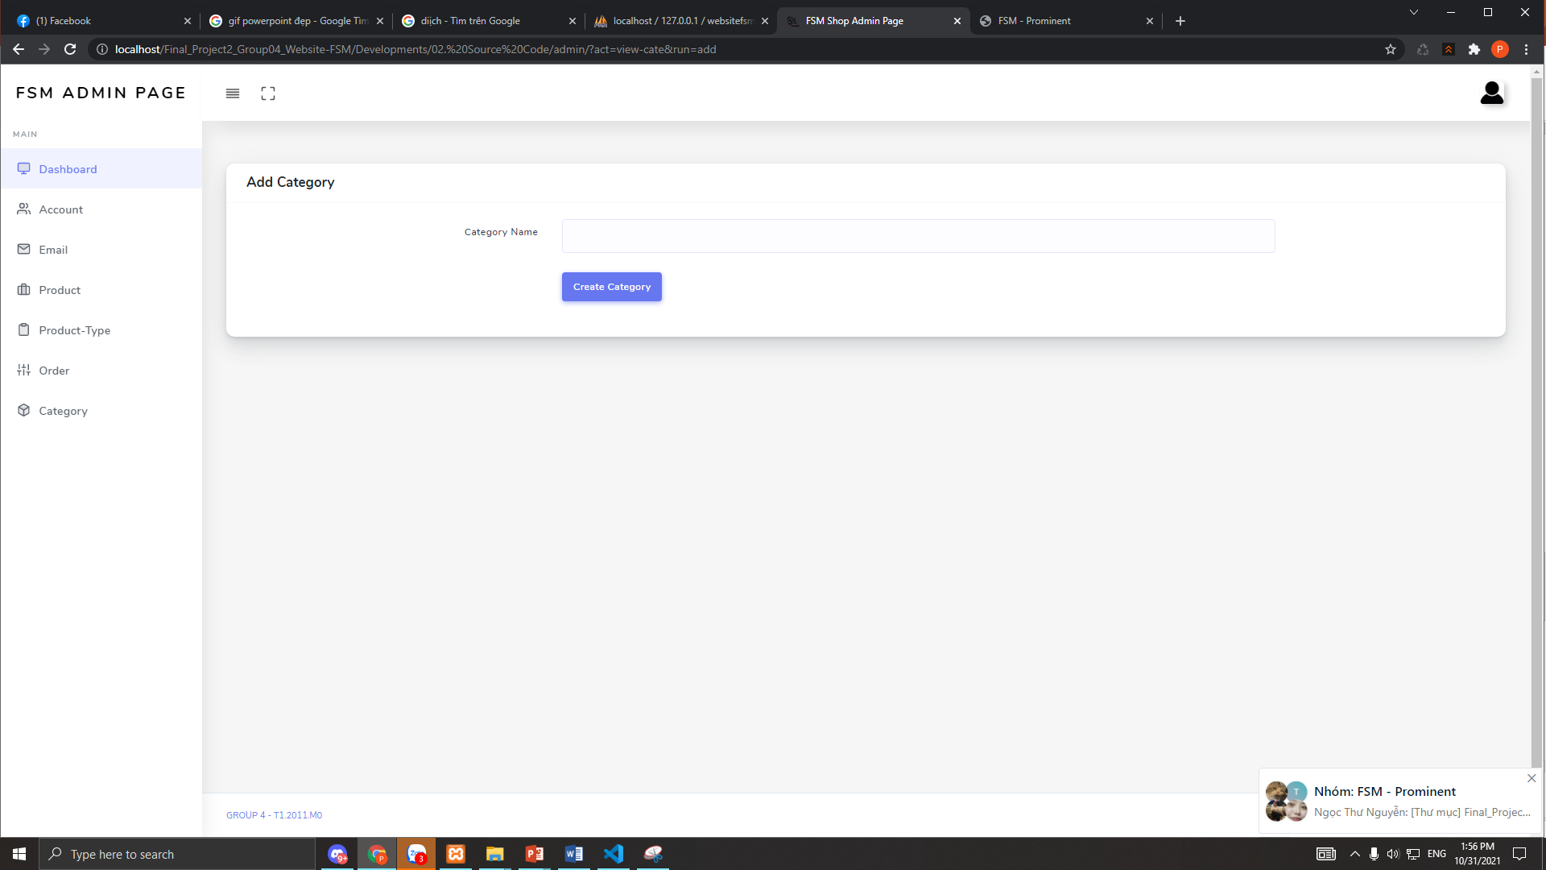
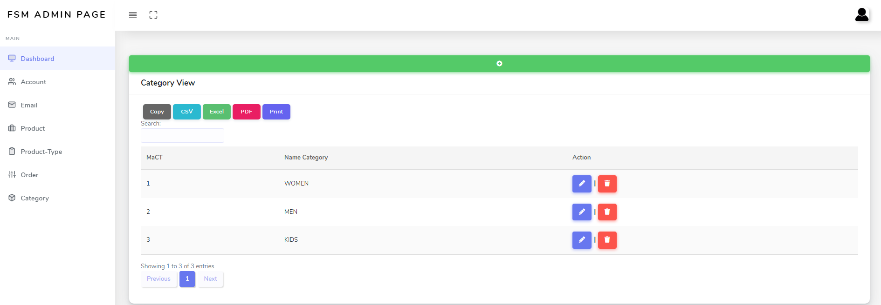
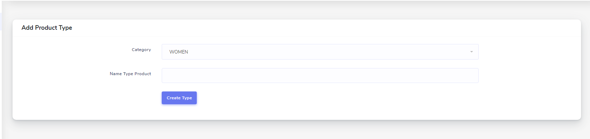
Edit category page
View product – type page
Bui Dai Thang
Add category page
View category page
Add product – type page

Slide 11
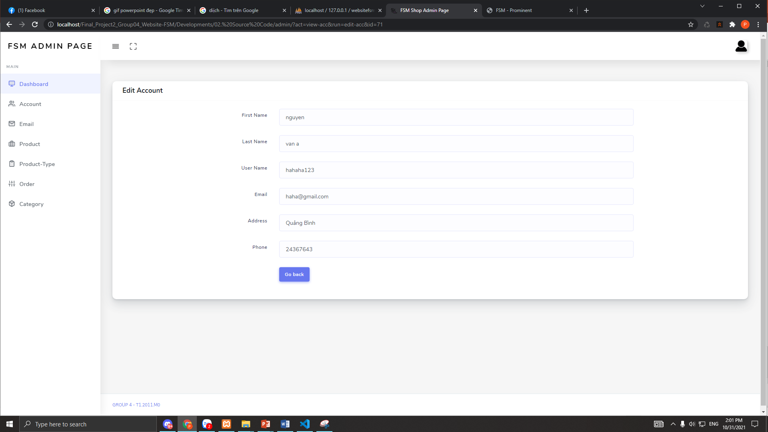
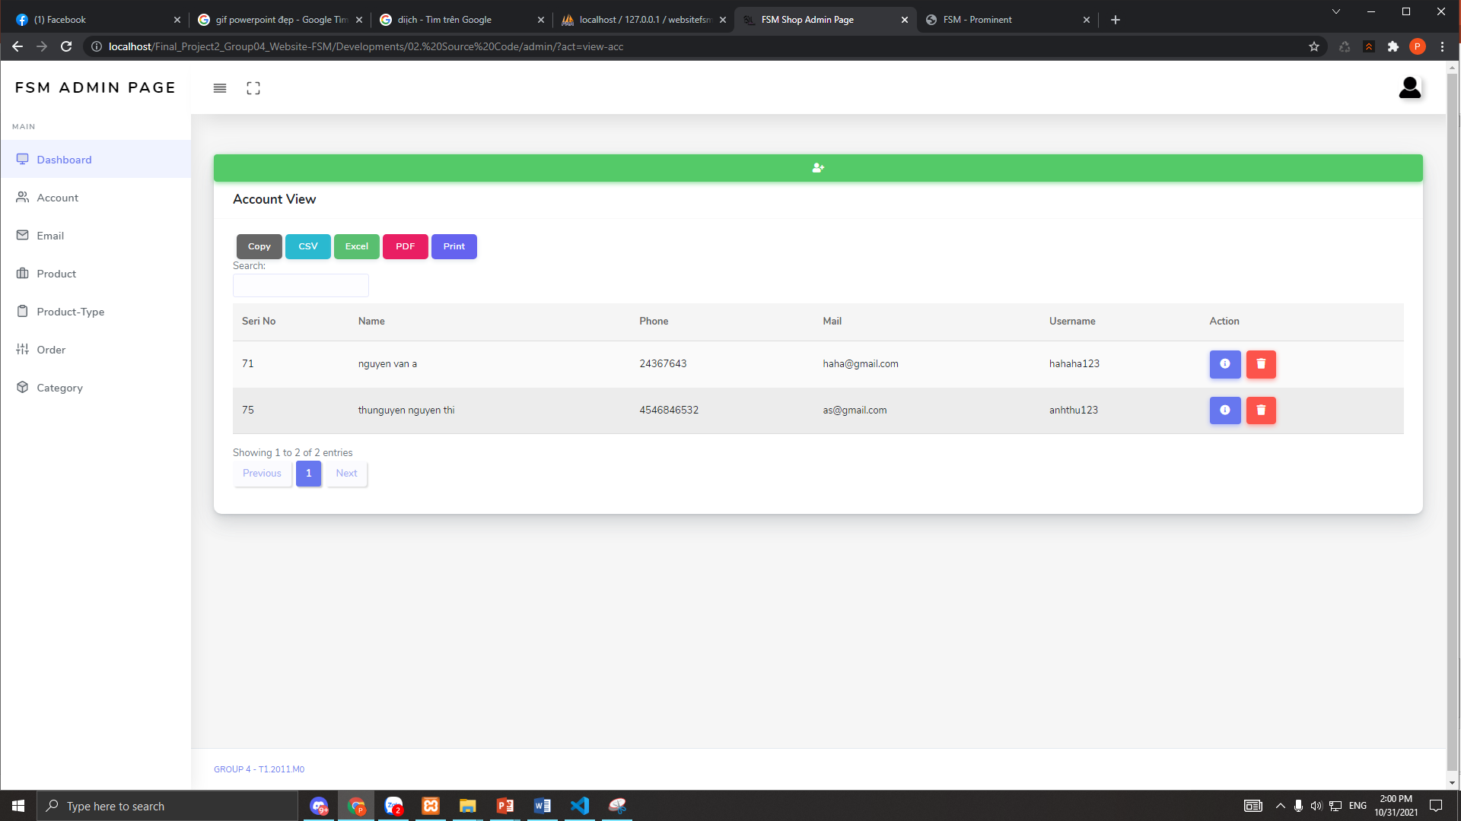
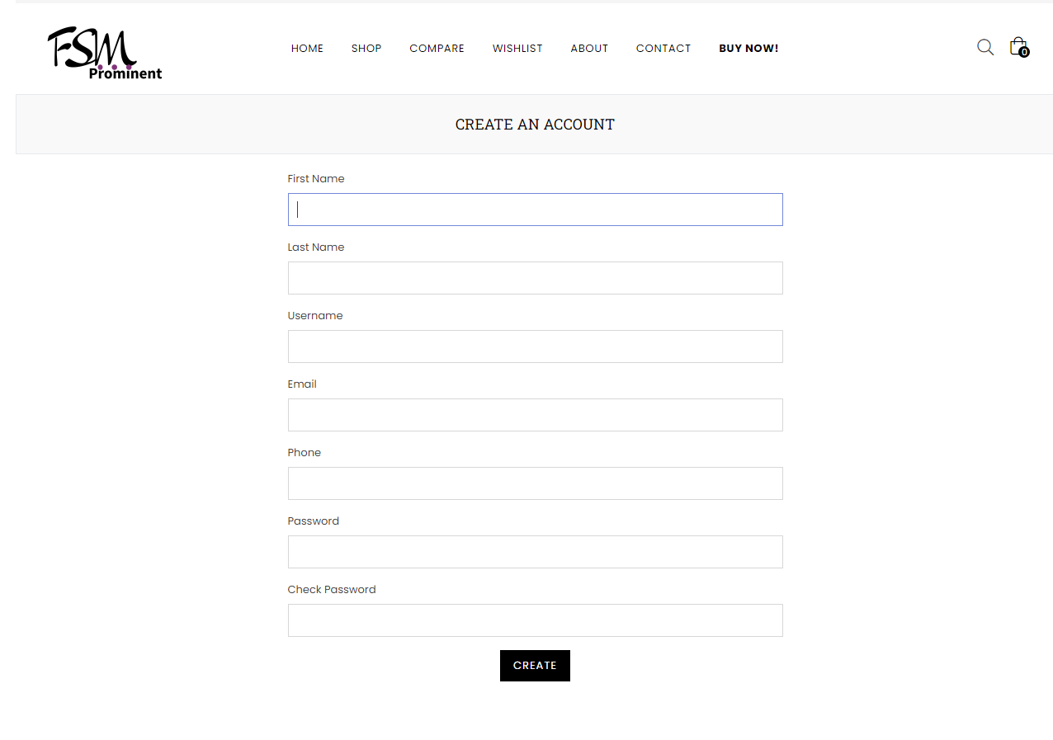
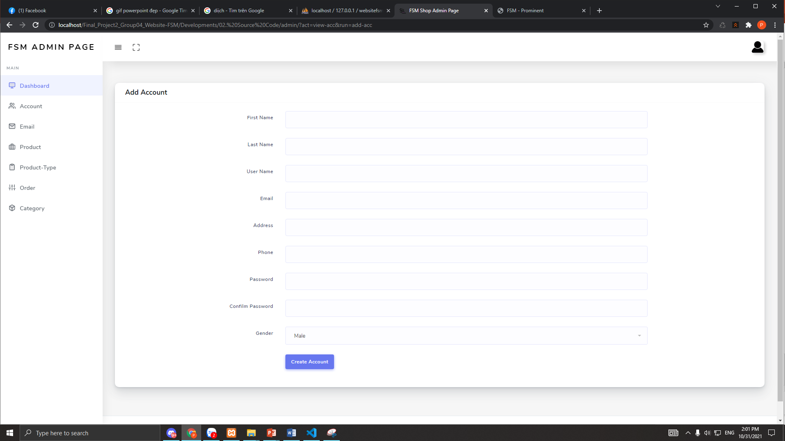
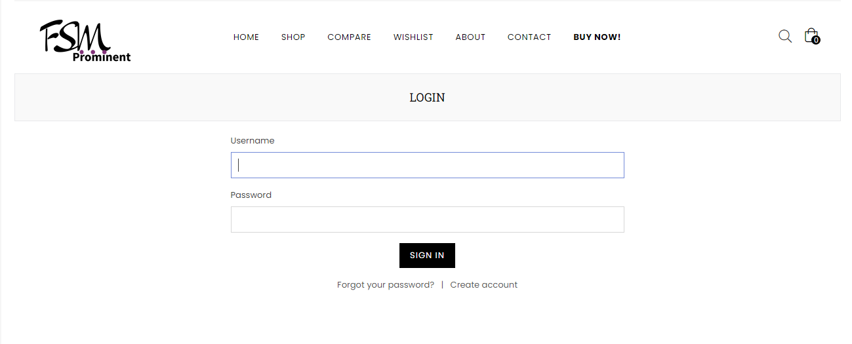

Account view page
Edit account page
Tran Trung Nghia
Creat account page
Register page
Subsrice form
Login page

Slide 12
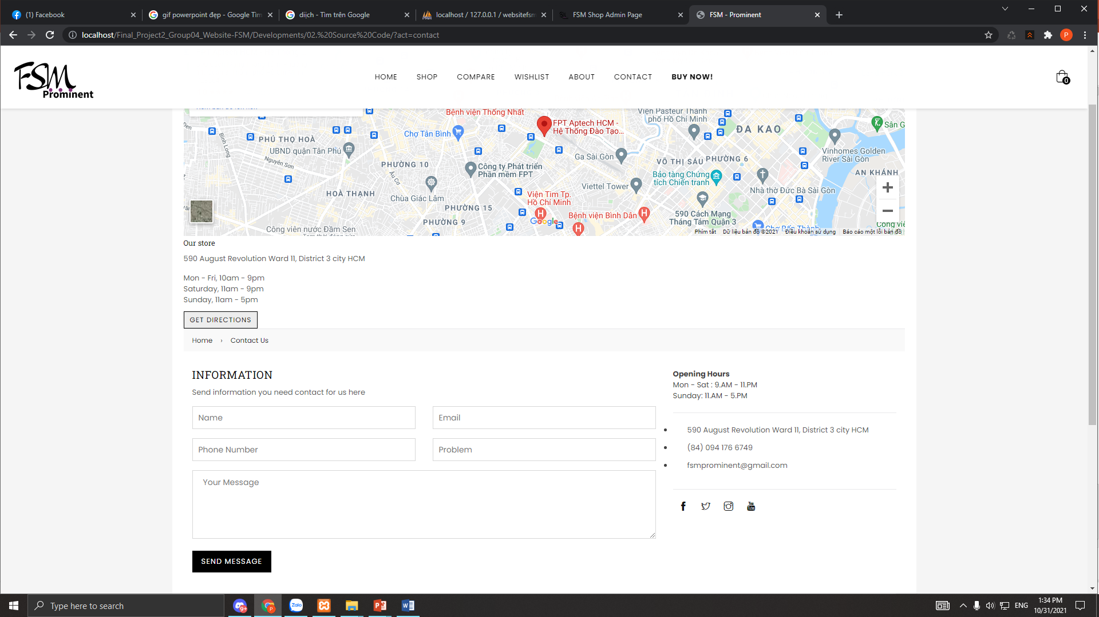
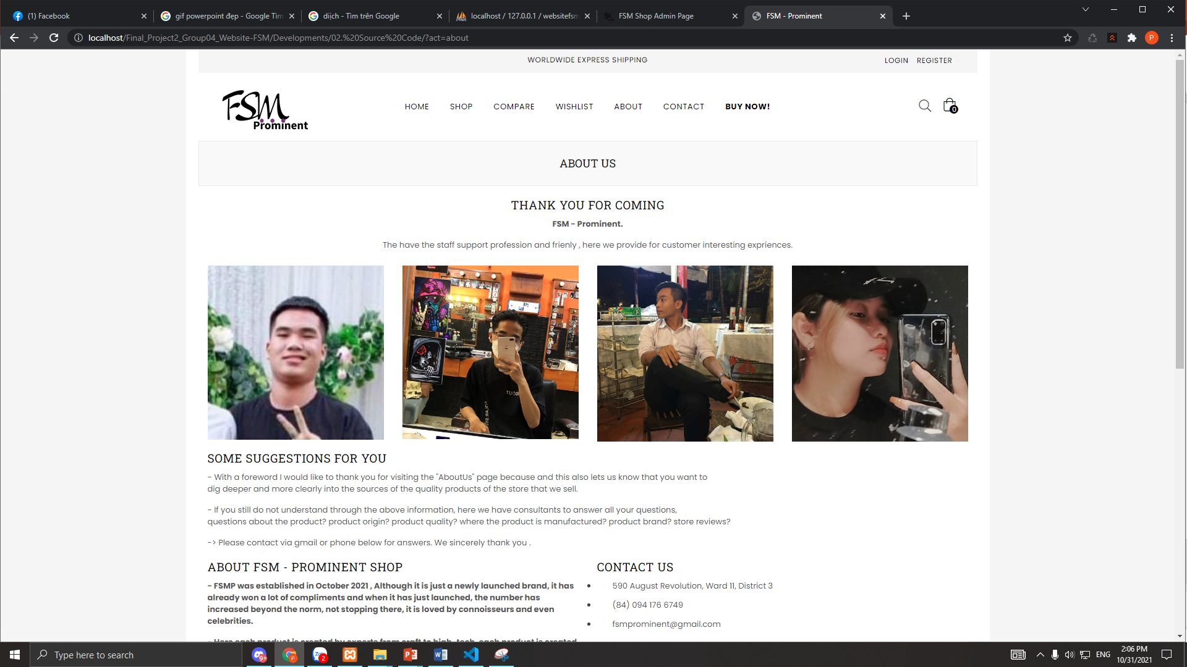
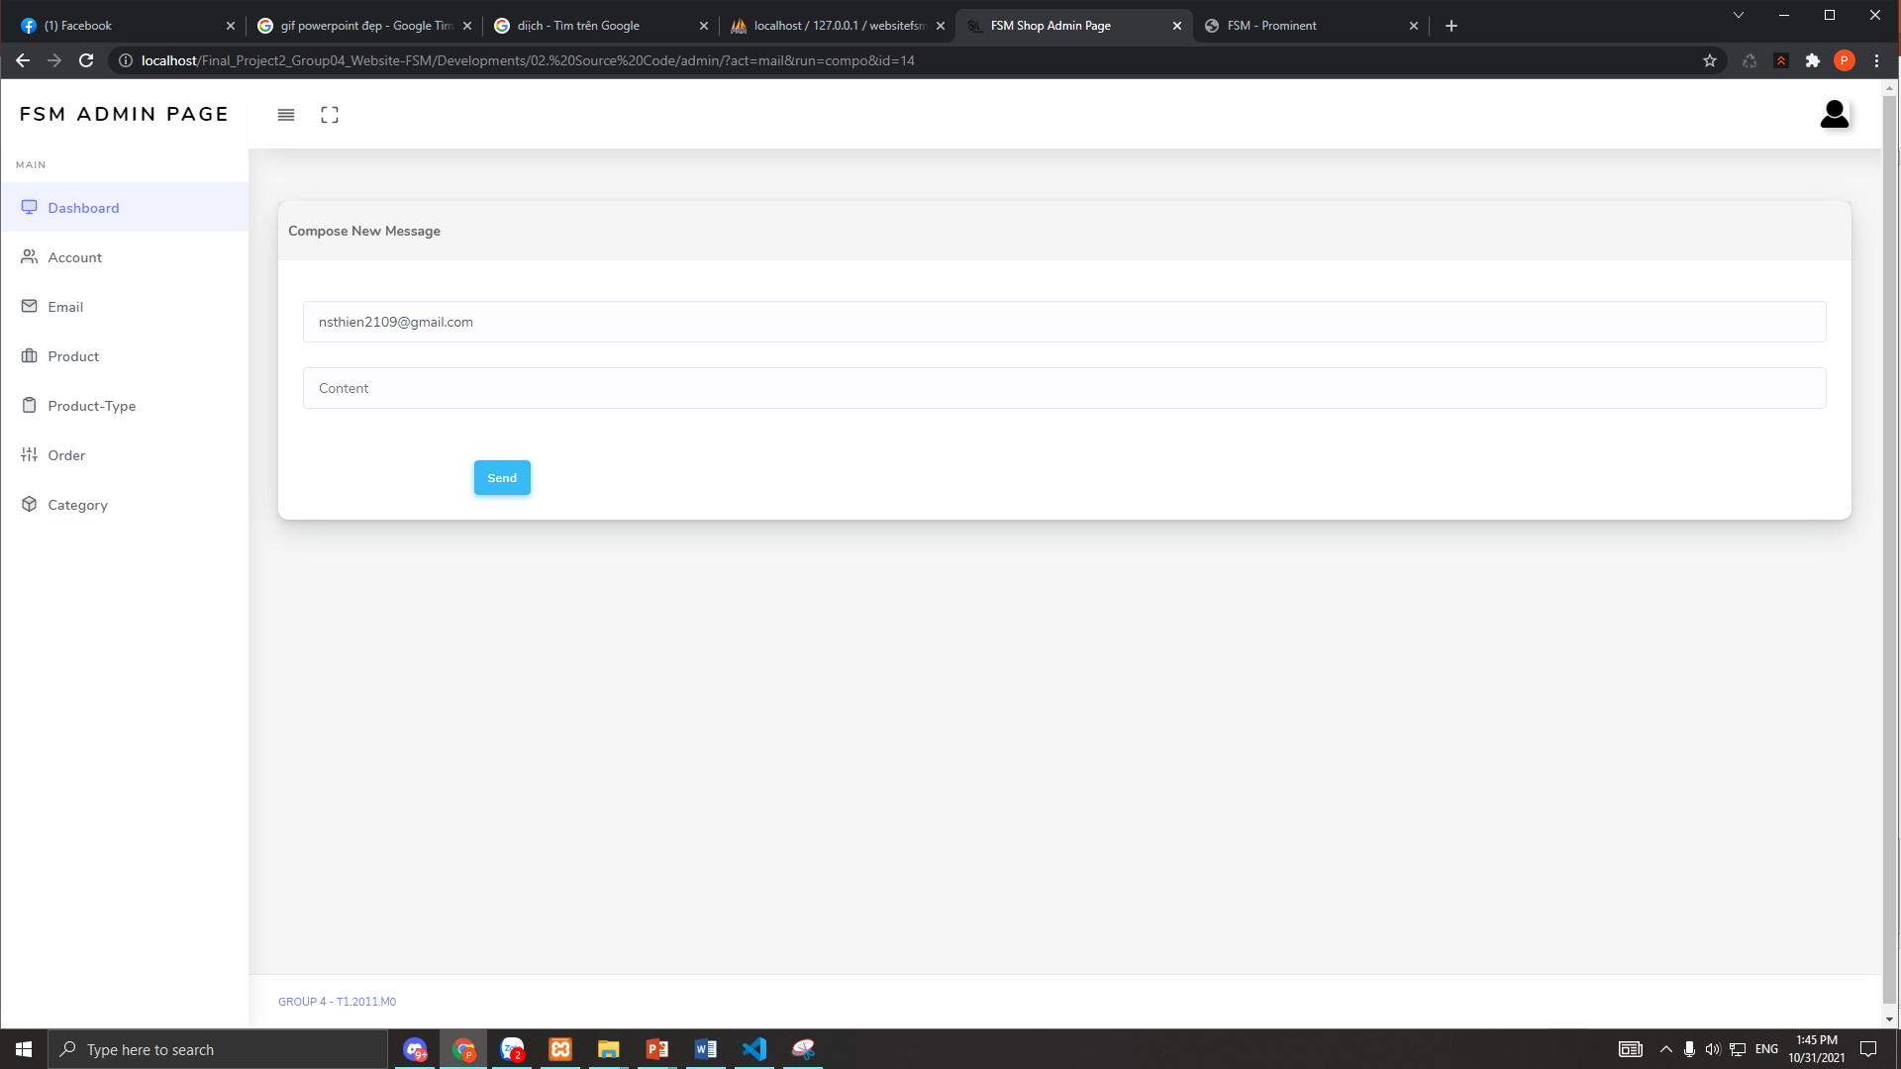
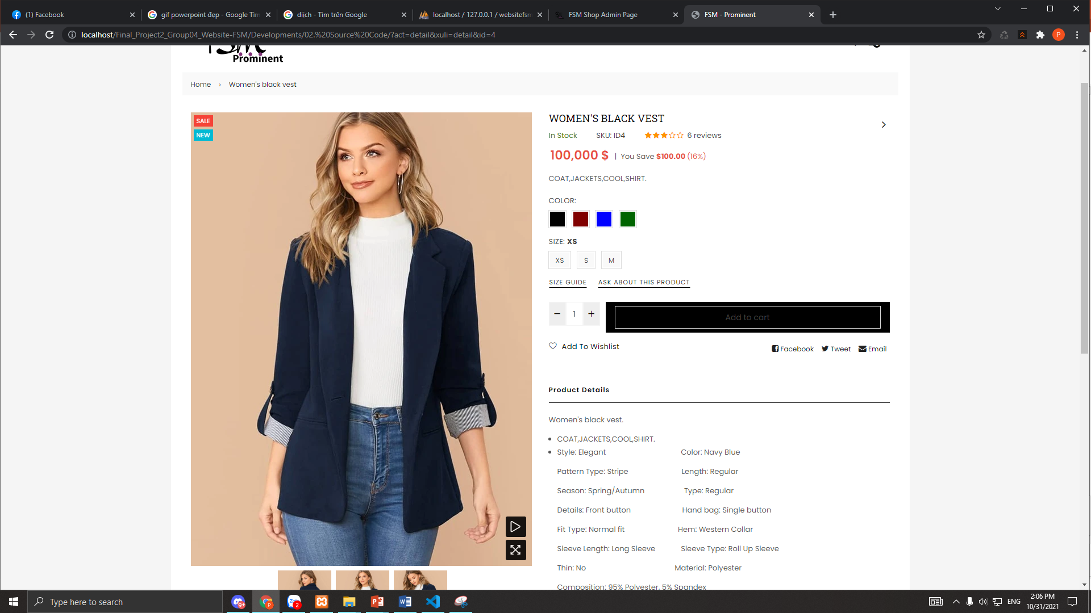
Contact page
About us page
Nguyen thi Anh Thu
Reply page
Details product page

Slide 13
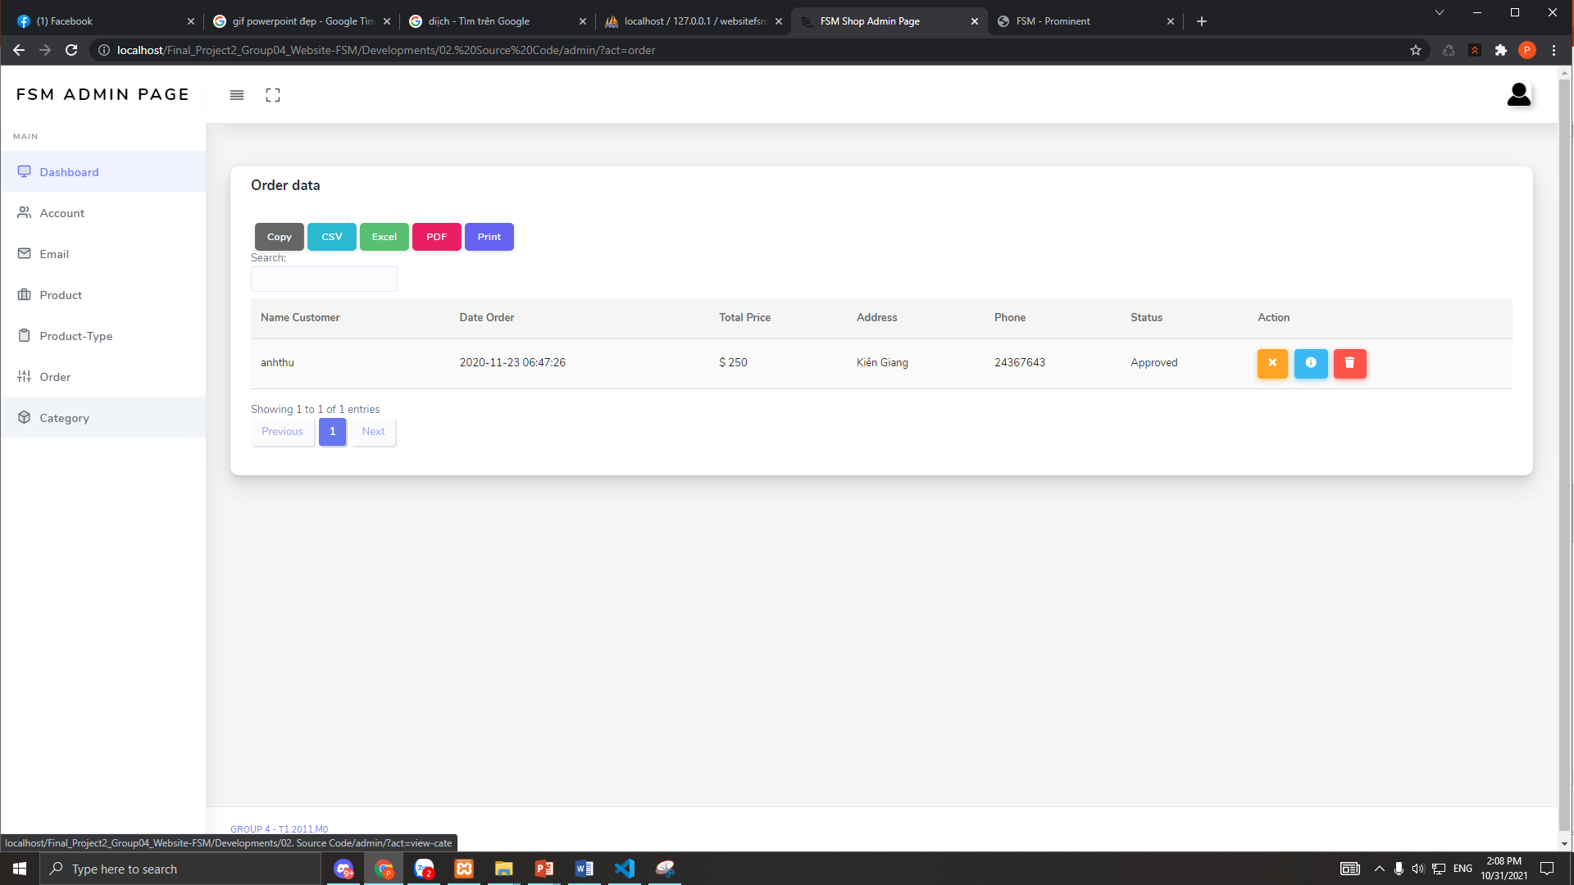
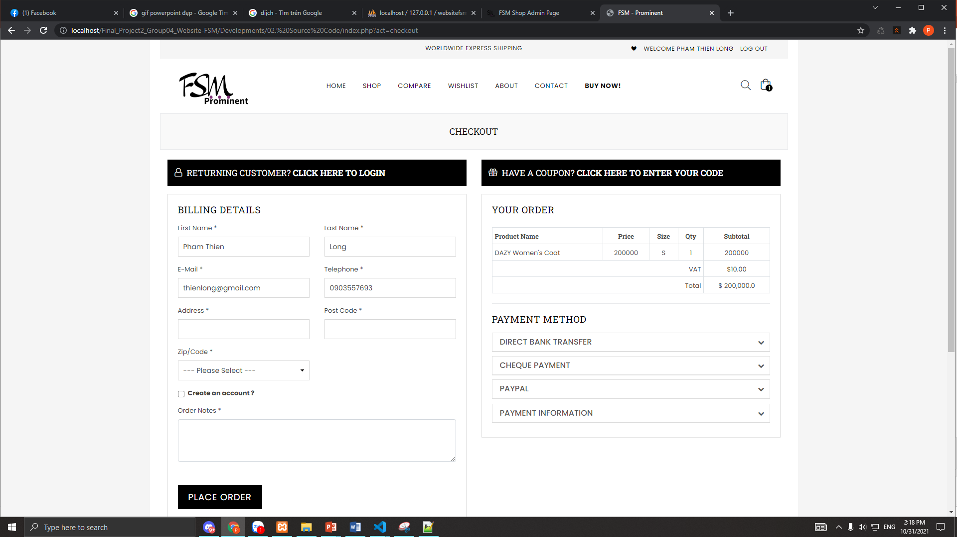
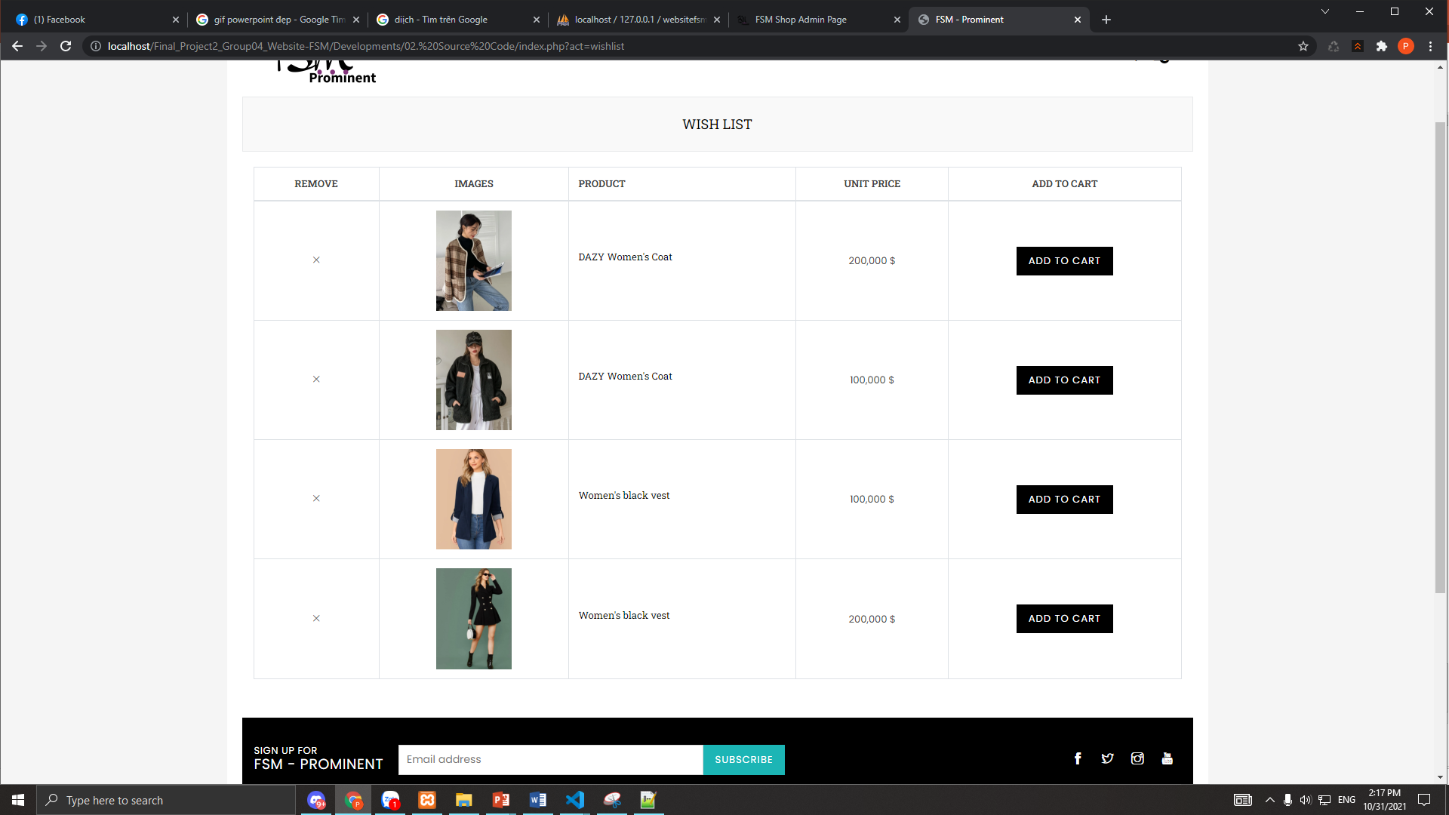
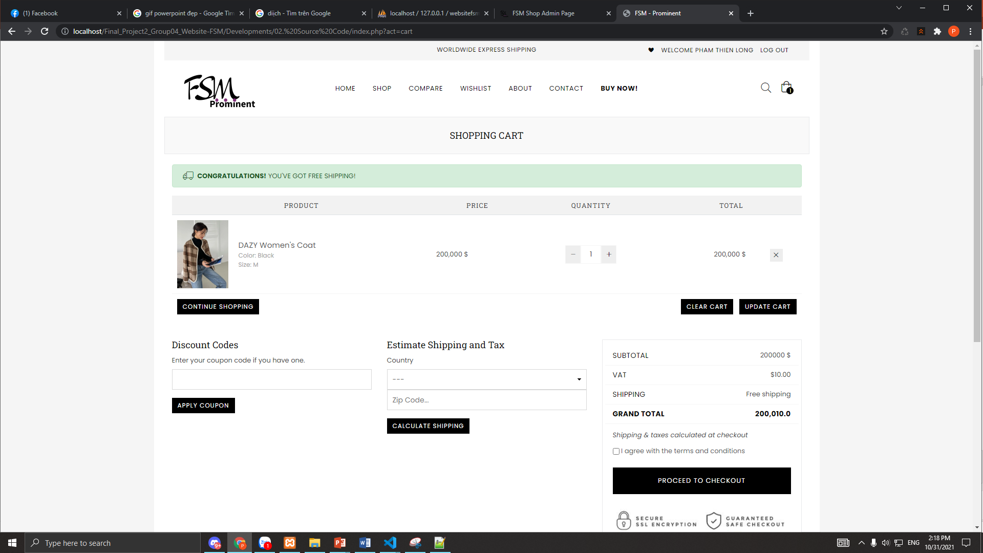
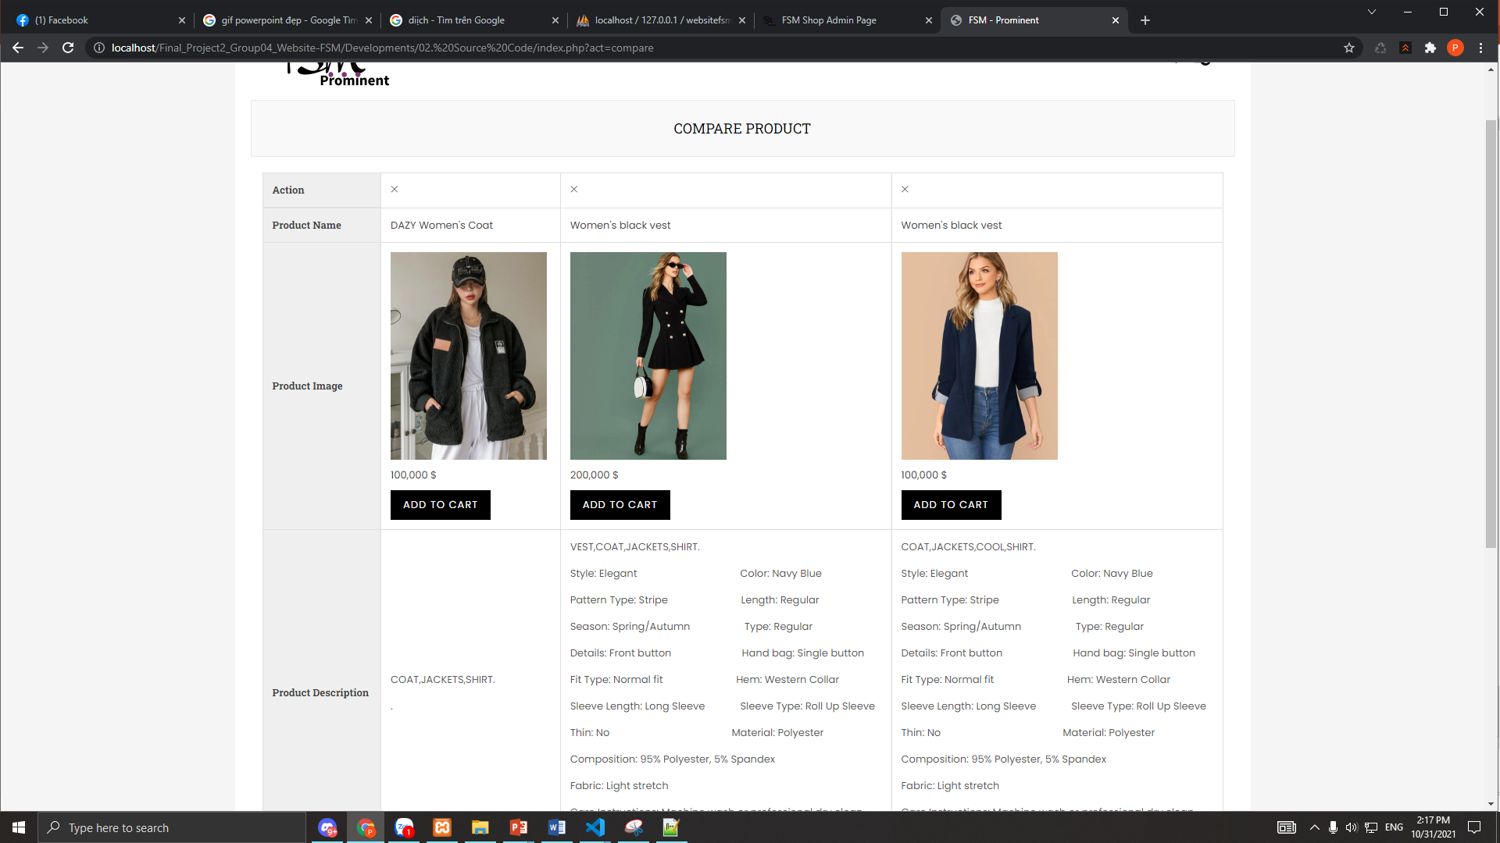
Check out page
Order details page
Nguyen thi Anh Thu
Cart page
Wishlist page
Compare page
Bui Dai Thang

Slide 14
Defect
Because it is at the start-up stage, HARMONIC does not have a remuneration system as well as a membership registration function for loyal customers.
The interface is still incomplete and still has many flaws.
In the future, it will be necessary to try to develop more functions so that users can easily access and use the web in the best possible way.

Slide 15
Thank you so much for listening to our presentation today
GROUP 4 FSM – PROMINENT WEBSITE T1.2011.M0

